Slide 1
Obtaining reliable feedback from students about teaching
Ed Roper
Brisbane Grammar School
Lawrence Ingvarson
ACER

Slide 2
Teaching Development Cycle Guiding Principles
engagement by all teachers is expected;
the development of a shared language of effective teaching at BGS; and
the most important element in the cycle is the teacher.

Slide 3
Early work
Student feedback via surveys since 1996
Individual teacher use
Confirmation appraisals
Anonymized faculty use
Notes:
desensitized

Slide 4
Early work
 | Statement | 1 Strongly Disagree | 2 Disagree | 3 Agree | 4 Strongly Agree
C | I feel accepted and respected in this class. |  |  |  | 
C | I know which behaviours are acceptable in this class. |  |  |  | 
C | I know the purpose of the work I am asked to complete in class. |  |  |  | 
R | I am able to do the work I am asked to complete in class. |  |  |  | 
C | I get help from other students when I need it. |  |  |  | 
C | I get help from my teacher when I need it. |  |  |  | 
C | Lessons are organised so that students can learn. |  |  |  | 
T | My teacher knows my strengths and weaknesses. |  |  |  | 
T | My teacher knows me as an individual. |  |  |  | 
T | My teacher gives me helpful feedback. |  |  |  | 
PH | I take time to think about and plan my work. |  |  |  | 
PH | I am good at getting the things I need before I start working on tasks. |  |  |  | 

Slide 5
Early work
T: relationship with the teacher
My teacher knows my strengths and weaknesses
C: classroom environment
I feel accepted and respected in this class.
PH: positive habits
I take time to think about and plan my work.
R: reflection
After finishing, I think about how to make tasks better.
Notes:
subscales

Slide 6
Early work
 | Relationship with teacher | Classroom environment | Positive habits | Reflection
4th Quartile | 3.34 – 3.41 | 3.26 – 3.38 | 3.06 – 3.15 | 3.21 – 3.34
3rd Quartile | 3.22 – 3.34 | 3.25 – 3.26 | 3.01 – 3.06 | 3.18 – 3.21
2nd Quartile | 2.97 - 3.22 | 3.22 – 3.25 | 2.96 – 3.01 | 3.16 – 3.18
1st Quartile | 2.80 - 2.97 | 3.06 – 3.22 | 2.89 – 2.96 | 3.08 – 3.16

Slide 7
Current work
AITSL professional standards for teachers
The Charlotte Danielson Framework for Teaching
Evidence about teaching from self-reflection, peers, supervisor, students …

Slide 8
Current work
ACER: look at reliability and validity of the surveys

Slide 9
Danielson Framework for Teaching | ACER STUDENT PERCEPTION SURVEY Scales | Australian Professional Standards for Teaching
Component 2a: Creating an Environment of Respect and Rapport: Teachers and Students work well with one another in this class | A01 The students in this class treat each other well A02 The students in this class help each other with their work A03 My teacher helps me to work well with other students in the class A04 Students feel comfortable asking this teacher for help A05 If I get something wrong in this class, the teacher doesn’t make me feel bad A06 My teacher encourages us to express our own ideas A07 When I answer a question, the teacher insists that other students pay attention. A08 My teacher listens to and takes notice of students' ideas. (Alpha: 0.91) | 4.1 Support student participation Establish and implement inclusive and positive interactions to engage all students in classroom activities
Component 2b: Establishing a Culture for Learning: Teacher encourages and motivates students | B01 My teacher thinks I can learn this subject B02 My teacher encourages us to ask questions B03 My teacher encourages everyone to participate equally in this class B04 My teacher makes me want to do well in this subject B05 My teacher cares how well I learn B06 My teacher listens to our ideas and uses them in discussion B07 My teacher often invites students to ask questions if they don’t understand (Alpha: 0.93) | 1: Know students and how they learn 3.1 Establish challenging learning goals
Component 2c: Managing Classroom Procedures: Teacher is a good manager of classroom routines. | C01 My teacher is well organised C02 My teacher makes sure we don’t waste class time C03 My teacher helps to keep the class on track C04 My teacher explains the subject clearly C05 My teacher manages classroom activities smoothly C06 My teacher gives clear instructions about activities in this class C07 I usually know what I’m supposed to be doing in this class and why (Alpha: 0.93) | 4.2 Manage classroom activities Establish and maintain orderly and workable routines to create an environment where student time is spent on learning tasks 2. Know the content and how to teach it
Component 2d: Managing Student Behaviour: Teacher sets high standards for student behaviour | D01 There is little misbehaviour in this class D02 My teacher treats students fairly in this class D03 My teacher makes it clear how we are to behave in this class D04 If students misbehave in this class, the teacher deals with it effectively D05 The teacher rarely has to raise his/her voice to gain our attention D06 Students don’t muck around in this class ( Alpha: 0.85) | 4.3 Managing challenging behaviour by establishing and negotiating clear expectations with students and address discipline issues promptly, fairly and respectfully.

Slide 10
Danielson Framework for Teaching | ACER STUDENT PERCEPTION SURVEY Scales | Australian Professional Standards for Teaching
Component 3a: Communicating with Students: Purposeful learning: Teacher is focussed on subject learning | E01 My teacher explains the purpose of each lesson clearly E02 My teacher makes clear how new lessons connect to earlier lessons E03 My teacher shows me how this subject helps me in real life E04 My teacher asks what we know about a topic before teaching it E05 My teacher explains why the subject is worth learning E06 My teacher is enthusiastic about teaching this subject E07 My teacher has made me more interested in this subject E08 The homework we do in this class is really worthwhile E09 I am making good progress in this subject because of my teacher (Alpha: 0.93) | 1.2 Understand how students learn 2.1 Content and teaching strategies of the teaching area 3.1 Establish challenging learning goals 3.2 Plan, structure and sequence learning programs
Component 3b: Using Questioning/ Prompts and Discussion Techniques: Intellectual engagement | F01 My teacher often asks questions that make me think F02 My teacher often uses questions that start interesting class discussions about what we are learning F03 My teacher makes sure that I get a good chance to contribute to class discussions F04 My teacher asks for our ideas about topics and makes use of them in class discussion F05 If I find the work difficult, this teacher can explain it in other ways that help me understand F06 This teacher is interested in my ideas F07 This teacher often invites us to contribute to class discussions (Alpha: 0.94) | 3.3 Use teaching strategies: Select and use relevant teaching strategies to develop knowledge, skills, problem solving and critical and creative thinking

Slide 11
Danielson Framework for Teaching | ACER STUDENT PERCEPTION SURVEY Scales | Australian Professional Standards for Teaching
Component 3c: Engaging Students in Learning: Active student engagement | G01 We usually have interesting activities and assignments in this class G02 We keep working in this class even when the teacher has to leave the class for a while G03 My teacher makes me think about what I am learning and whether I really understand it G04 The teacher involves us in activities that really grab our attention G05 In this class we sometimes get so involved in our work that the end of the lesson catches us by surprise G06 This teacher usually gives us time to summarise what we have learned at the end of lessons (Alpha: 0.90) | 3.5 Use effective classroom communication: Use effective communication strategies to support student understanding, participation, engagement and achievement
Component 3d: Using Assessment in Instruction: Teacher monitors achievement and gives good feedback | H01 My teacher understands my strengths and weaknesses in this subject H02 My teacher keeps me up to date with how well I am doing in this subject H03 My teacher knows when I have difficulties understanding something. H04 My teacher helps me to understand why I get something wrong H05 My teacher gives me useful feedback about my work H06 My teacher often checks how well I understand what we are learning H07 My teacher explains clearly how my work will be assessed H08 My teacher sets high standards for what is expected of me (Alpha: 0.94) | 5.1 Assess student learning Demonstrate understanding of assessment strategies . . . 5.2 Provide feedback to students on their learning Demonstrate understanding of the purpose of providing timely and appropriate feedback . . .

Slide 12
Using the feedback
Individual class
Groups of classes
Subject groups
Year groups
All classes

Slide 13
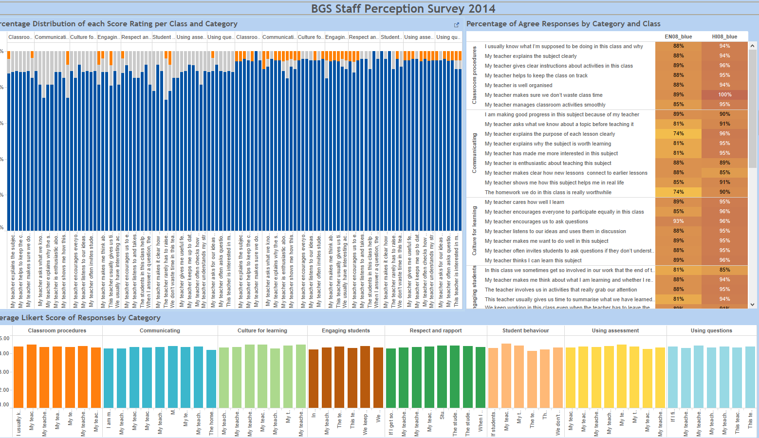
Individual class

Slide 14
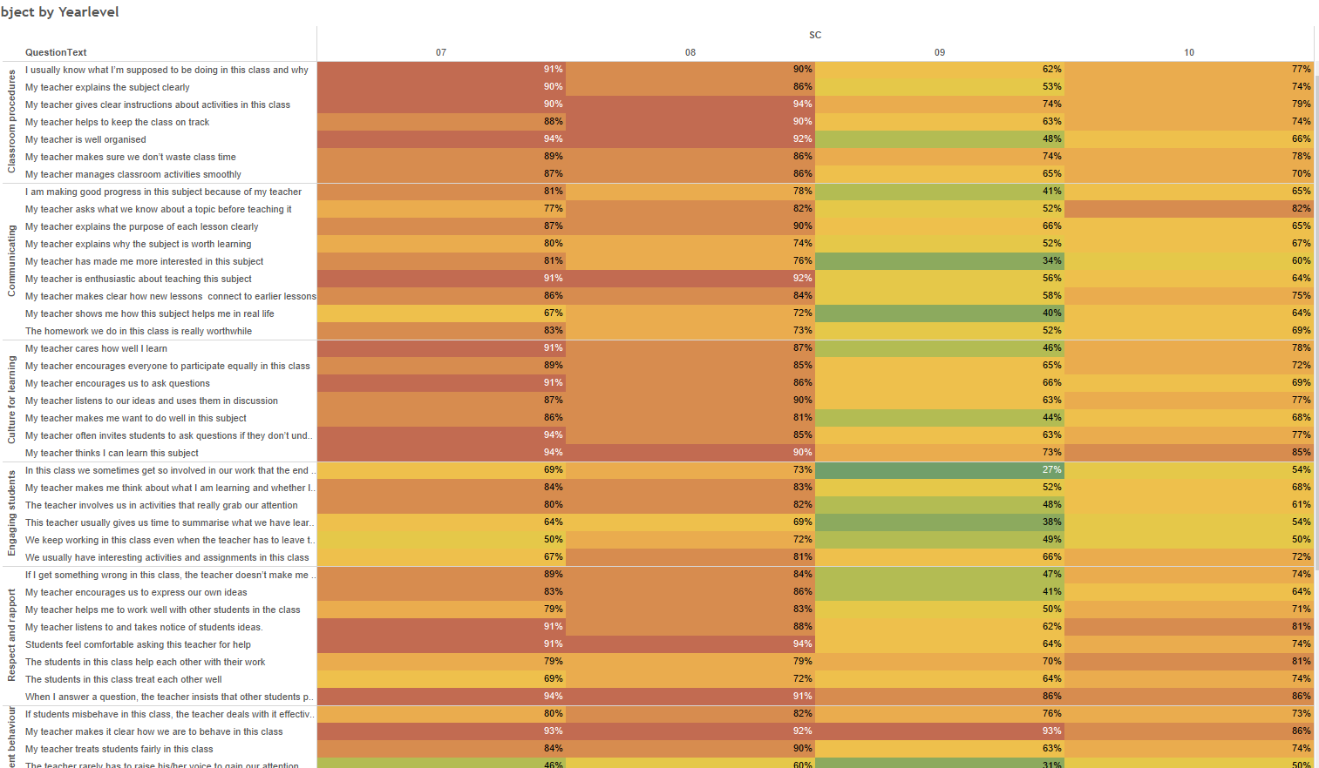
Groups of classes (subject)

Slide 15
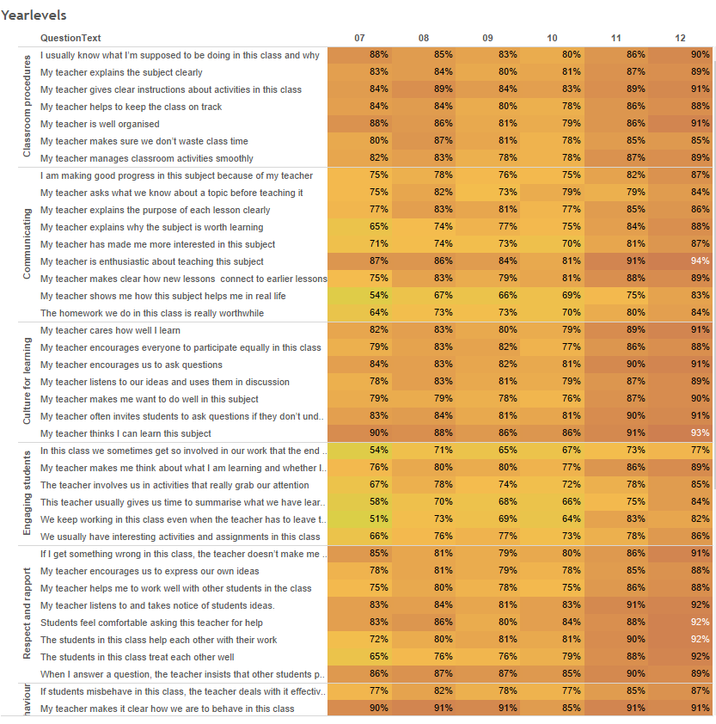
Groups of classes (year groups)

Slide 16
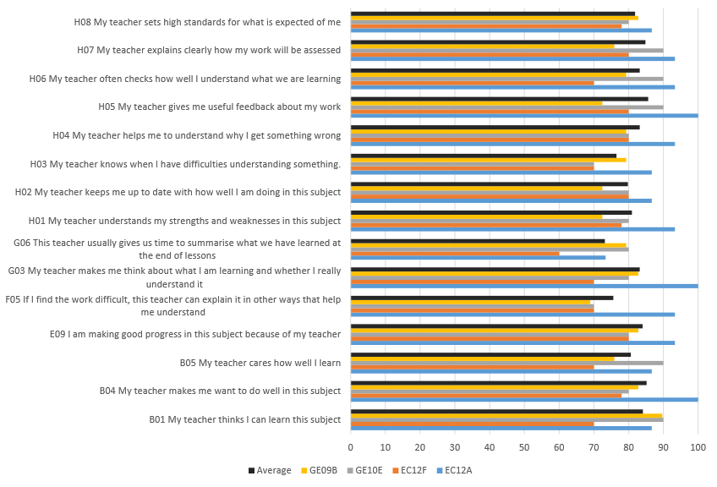
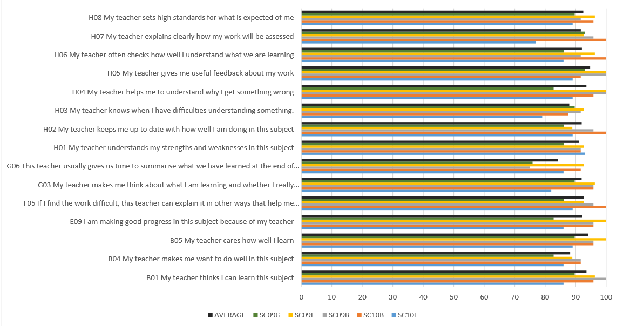
Students’ perception of the impact of teaching on their learning

Slide 17
Future
Upper primary version
Correlations with:
Teacher self-reflections
Observation data

